Slide 1
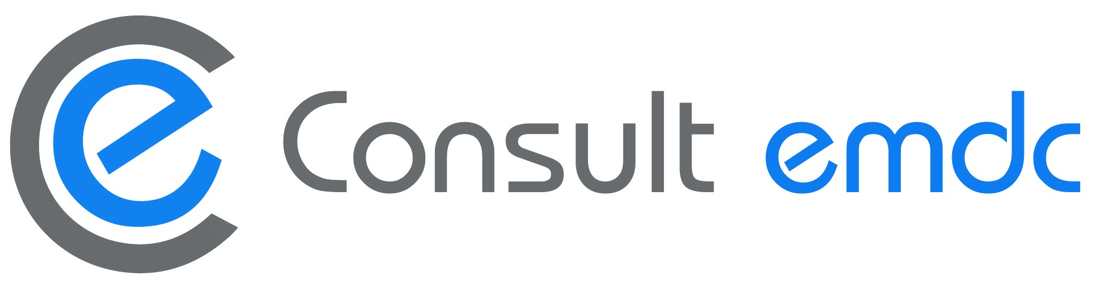

Slide 2

Our Past & Present
1979
  Creation of CONSULT, specializing in Mechanical, Electrical & Plumbing Design, Vertical Transportation and Value Engineering and Peer Review services.
2008
  Creation of EMDC as sister company, enhancing Consult’s workforce and adding to the group a deep expertise in ICT Systems and Renewable Energy Technologies in the Design and Shop Drawings services.
  Creation of CONSULT EMDC FZCO in the UAE to become an attraction hub for an expanding clientele. The purpose of CONSULT EMDC is to secure coordinated solutions in terms of Mechanical, Electrical, Plumbing & ICT Engineering as well as BIM solutions starting at 3D and extending till 6D.
2020
2020
  Collaboration between CONSULT EMDC and Optimal Engineering Company for Engineering Consultancy (RCS) - registered in Saudi Arabia - whereby CONSULT EMDC offers electrical, mechanical and plumbing designs and technical support services while RCS ensures the necessary representation in the Saudi market. RCS is thus locally representing CONSULT EMDC in KSA, securing that their services are fully compliant with the Saudi requirements and is managing CONSULT EMDC’s delegated engineers in KSA. CONSULT EMDC is represented in RCS management board.
  CONSULT EMDC established a branch office in Cairo, engaging in similar MEP activities, completing them by a startup team of Architects.
2021
  CONSULT EMDC acquires the ISO 9001 certification, meeting the prequalification's requirements of international companies. The certification was successfully renewed in 2024 with zero nonconformities from the certification body.
2023

Slide 3
Who We Are
We are guided by optimism. We use the power of design to inspire a positive change and create a future that promotes wellbeing for all, in line with the latest sustainability trends. We focus on the importance of preserving nature and its resources and encourage our clients to apply any opportunity to reduce the overall impact of the built-up environment on the human health and the natural ecosystem.
We are a diverse team. Our team is composed of experts in the latest Engineering trends in Renewable Energies, Green Building designs, HVAC Systems technologies, Water Systems efficiencies, Power Generation & Distribution as well as new technologies in IT & Low Current systems. Our aim is to provide Total MEP Integrated Solutions, customized to meet the full spectrum of Engineering services through a constructive cross-discipline collaboration.
We invest in innovation. In a time of transformation, engineering tools play an intense role. To meet new expectations, we are pushing the boundaries of design by smartly using AEC modeling technologies offering integrated construction models and virtual reality rendering. We are even unlocking and creating new tools to release fast innovative solutions serving the construction industry. We promote advanced education within our teams specially in terms of technology and sustainability, through certificates and diplomas acquired from accredited universities and international organizations.
We expand our market. With the communications technology evolutions, boundaries for project’s locations dropped and gave us rise to the opportunity to connect with new clients expanding from the Gulf Countries to North American Countries - mainly Canada. From our side, this expansion enabled us to gain a competitive edge in undersaturated markets, foster our expertise through the diversity of shared opinions and methodologies; from our client’s side, this expansion offered them the opportunity to diversify their services, to access additional talents and to reduce their costs.

Slide 4
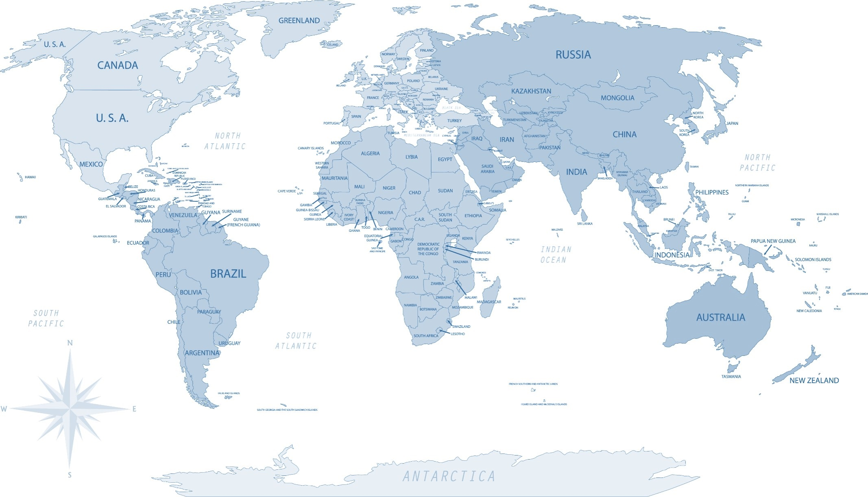

Where We Are
LEBANON
Beirut
 +961 1 833 710
Jal el Dib
 +961 4 710 253
DUBAI
 +971 54 421 1769
CAIRO
    +20 100 0517495
RIYADH
 +966 59 120 0734

Slide 5
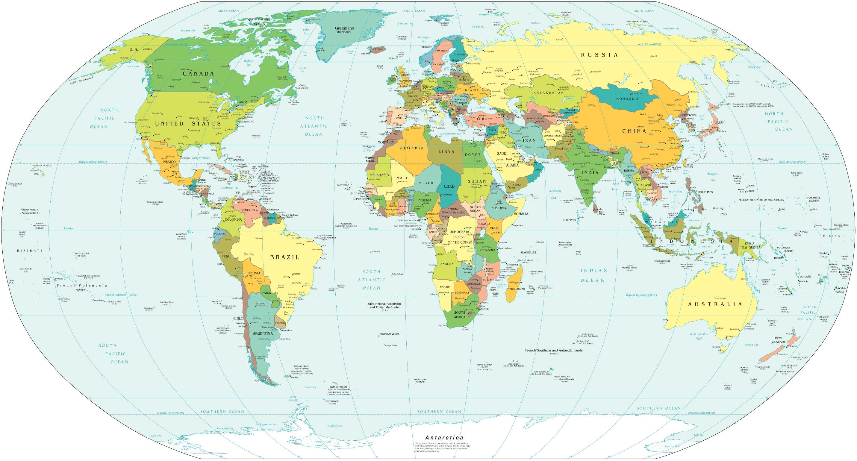


Our Projects Locations
Notes:
This is a brief of the history and background of EMDC, as it is exposed to International Operations.
EMDC group has been established in 2008, in Jal EL Dib, Lebanon. During the first years, from 2008 till 2010, our projects were mainly located in Lebanon and Saudi Arabia. Since 2011, our markets expanded to also include Iraq, Guinea, Ivory Coast, Nigeria, Tanzania, Ghana, Congo Brazaville and UAE, as shown in the map. Lately, since December 2016 till current date, Latin America and Pakistan became one newest market.

Slide 6
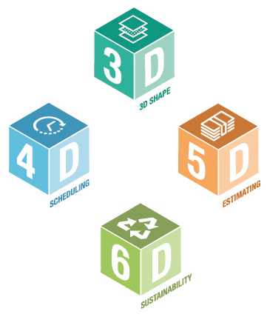
Our BIM Know-How
The use of BIM is now mandated to ascertain that the planning, design, and construction of projects is a collaborative process with a high-efficiency output. For this purpose, EMDC invested in the BIM world allowing the 3D simulation of the projects before their execution, facilitating visualization and coordination, analyzing and resolving potential clashes, reducing the risk of abortive works on site and finally making more informed decisions.
Further to the 3D modeling employed for construction and fabrication, EMDC can offer its clients the essential functionalities of BIM models through BIM 4D to 6D, starting with scheduling tasks, estimating costs and extracting quantities and performing energy analysis.
Throughout the projects, EMDC got acquainted with BIM components which play a crucial role in the successful implementation and management of BIM projects, like Common Data Environment (CDE), BIM Execution Plan (BEP), COBie (Construction Operations Building Information Exchange), IFC (Industry Foundation Classes), Asset Information Model (AIM), FM (Facility Management) Integration, GIS (Geographic Information Systems) Integration, 4D and 5D BIM, Virtual Reality (VR) & Augmented Reality (AR) as well as Smart Building Technologies.
We, at EMDC, enriched our BIM expertise by closely developing BIM models to renown companies, listed in a later section, integrating the MEP Revit materials families from their selected suppliers, their method of statement and showing their installation and fabrication methods in their details and finally submitting a coordinated model as per the presentation technique expected in each company.
Finally, as a contribution to the worldwide BIM community, we participated in Autodesk University classes to share our insights about the Automation tools developed in house, automating time-consuming design tasks using Forge and Machine Learning. Both classes are found at the following links:
https://www.autodesk.com/autodesk-university/article/Combining-Forge-and-Machine-Learning-Automate-Time-Consuming-Design-Tasks-2021
https://www.autodesk.com/autodesk-university/class/Beyond-Dynamo-Powerful-Automation-Potential-Forge-and-Revit-API-2021

Slide 7

Our Success Indicators
In House R&D
We internally developed automation processes and even featured them in Autodesk University.
Also, we developed in-house BIM tools related to each project’s needs.
Data Security
We securely back-up our projects on redundant servers with redundant internet connections as well as via subscription on a Remote Server (Cloud), through latest HP servers Technology.
Development of Virtual Reality & Augmented Reality
We provided our clients with a collection of navigation tools by converting selected areas with particular importance into virtual and interactive environments.
BIM Proficiency
We delivered coordinated Revit models using advanced BIM logistics like Navisworks clash tests, MagiCAD and plugins and add-ons.
We continuously keep our teams updated with the latest changes of Autodesk AEC collection.
Value Engineering & Design Review
We performed Value Engineering and Design Review tasks on designs made by renown international companies.
Shop Drawings
We delivered 10,000 shop drawings within
9 months including client’s comment implementation as well as a LOD 400 Revit model and Navisworks model with zero clash for a 250,000 sq.m. mega carpark within 4 months. Moreover, we developed fabrication drawings for projects in Canada, USA, Australia.
Design expertise
We gain our ample expertise through close coordination with International Designers and while executing Value Engineering and Shop Drawings projects.

Slide 8
What We Do : MEP & ICT
Power System
Power Generation & Distribution
Lighting System
Interior and Exterior
Façade Lighting
Lighting Controls
ICT Systems
Data System
Telephone System
Security Systems
Fire Alarm System
Electrical Infrastructure
Power Plants & Power Network
Renewable Energy Integration
Emergency Power System
Grounding and Lightning Protection
Emergency / Egress Lighting
Central Battery System
TV System
Audiovisual System
Public Address System
Access Control System
Closed Circuit Television System
Information Technology Network
Security Systems Network
HVAC System
DX, VRV & Packaged Air Conditioning
Plumbing System
Domestic and Potable Water
Fuel Oil, Gasoline & LPG
Fire Protection System
Fire Suppression
Mechanical Infrastructure
Central Plants
Centralized Chilled Water
Building Automation
Smoke Evacuation & Control
Sanitary, Waste and Storm Water
Steam Systems & Irrigation Systems
District Cooling
Boiler & Fuel Plants
Energy Management & Control
Hazardous Wastes
Fountains, Waterfalls & Pools
Medical Gases
Sprinkler System
Dry and Wet Chemical Extinguishing
Pumping Stations
Water Network
Drainage Network
Fire Network
HVAC Network
Vertical Transportation
Traffic Analysis
Transportation Simulations
Average Wait Time Calculations
Peak Time Projections

Slide 9
What We Do : Energy & Sustainability
Solar Poly-Generation
  Solar Cooling
  Solar Heating
  Solar for Hot Water Generation
  100% Solar Fraction System
  Thermodynamic Solar System
  PV-Heat Pump System
  Organic Rankine Cycle
  Phase Change Thermal Storages
Solar Cooling
PV Electrical Power Generation
Smart Thermal Networks
Smart Grid
District Solar Cooling/ Heating Plants
Geothermal Energy
Renewable Energy Systems
Environmentally responsible and resource-efficient Design
Efficient use of Energy, Water and other Resources
Protection of Occupants' Health
Improvement of Productivity
Reduction of Waste and Pollution
Sustainability & Green Design
Energy Solutions
Energy Management Analysis
Energy Reduction Percentage from systems enhancements
Optimizing efficient HVAC Systems
Full Energy Model for Cooling, Heating, Hot Water Energy
Methodologies towards Near-Zero Energy Buildings (nZEBs)
Energy Modeling
Pre-Site Stage
Document Collection Stage
Site Stage
Basic Understanding
Post Site Stage
Evaluation Stage with Final Report
Energy Audit
We, at CONSULT EMDC, acquired the essential diplomas and certifications in Energy & Sustainability.

Slide 10
Our Projects & Workforce
Design
Airports & Stations
Shop Drawings
Airports & Stations
Value Engineering
Airports & Stations
Commercial
Cultural
Education
Exhibitions
Governmental
Healthcare
High Rise
Hospitality
Industrial
Infrastructure
Leisure
Offices
Plants
Religious
Residential
Commercial
Healthcare
High Rise
Hospitality
Industrial
Infrastructure
Offices
Plants
Residential
Commercial
Governmental
Healthcare
High Rise
Hospitality
Industrial
Offices
Leisure
At CONSULT EMDC, we specialize in BIM modeling and coordination, providing professional expertise in implementing the BIM platform across various projects. From the outset of each project, a dedicated BIM Manager is assigned to ensure that the BIM methodology is fully understood and seamlessly integrated. This ensures that the project team can effectively apply BIM principles throughout the project's lifecycle, optimizing efficiency, collaboration, and precision.

Slide 11
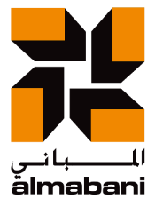


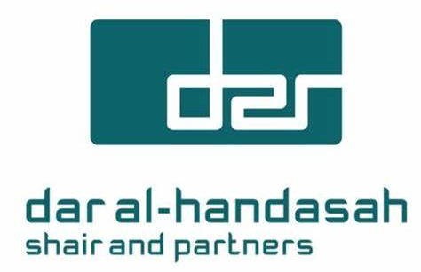














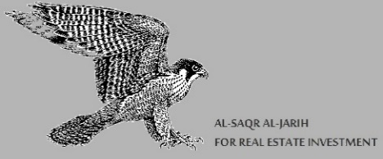
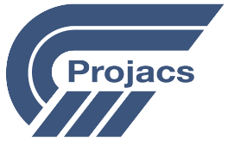



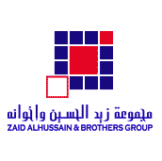
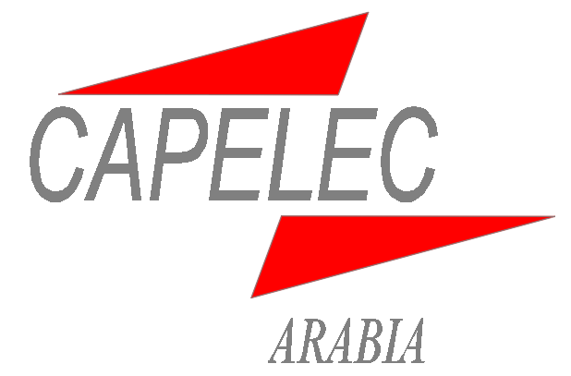

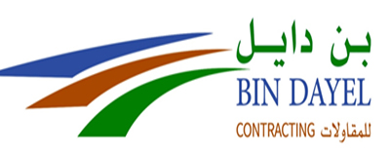






Our Major Clients
Notes:
In this slide, we have listed the major clients for the group.

Slide 12

Our IT System
Internet
2 x Fiber Optic
Cairo Office
Microwave Link
Private Cloud (USA)
Dubai Office
4G
BIM Collaborate
Pro & MS 365
Autodesk Forge
Beirut Office
HP DL380
HP DL380
HP DL180
HP DL360
BIM Server
Work Server
V
Work Server
Z & X
Shared Licensed Software
FORTIGATE Firewall
Active Direct
Active Direct
LAN
LAN
LAN
LENOVO EMC²
LENOVO EMC²
ASUSTOR
Seagate Armor
HP DL180
AVAYA
IP Telephony
Mirror for Data
Z, X, W & V
CONSULT EMDC
Office
NAS Y
NAS Backup Storage
(Server Z, X, V & Admin)
NAS Backup Storage
(Server V & Y)
NAS
Admin Storage
Notes:
Our IT system ensures a high security for data storage and information sharing, based on a 2N redundancy.
It is based on the latest generation 9 technology from HP for the mid-enterprise scale.
As shown, the system starts with a main server which is the HP DL380 (generation 9), subdivided into 3 virtual servers: one for DHCP, one for Exchange and one for ISA which plays the role of the firewall.
The main storage server is the HP DL180 (generation 9). It is dedicated to the storage (Z) of the ongoing projects. Also, it is configured to cater for the essential functions of the main server in case of its failure.
The system also includes 3 Network Area Storage (NAS) configured as follows:
The NAS Lenovo Iomega Store which is redundant to the storage (Z) of the DL180.
The NAS Lenovo EMC2 which contains the storage (Y) and which is dedicated to special projects.
The SEAGATE Black ARMOR which is redundant to the storage (Y) of the NAS Lenovo EMC2.
The configuration of all our hard disks is RAID 5. all our servers have a capacity of 8TB.
The system also includes the IP telephony server, the SQL server and the Security server for CCTV and Access Control. The SQL server monitors, controls and restricts the flow of data from our servers. This is an important guarantee for the confidentiality of information in our office.
The system is connected to the WAN through 2 redundant links: the Microwave link and the 4G link. As an ultimate security and to share data with external parties and clients, we have registered in a remote server in California. Some of our clients prefer to share data over the cloud storage like wetransfer or dropbox.
Finally, we are working on creating a dedicated cloud so that we can access all our files from any location worldwide.

Slide 13
Our Soft Skills
2013
2014
2017
1987
2019
Codes & Standards. Relevant codes set minimum standards for the design and construction of projects, including requirements for fire and life safety, accessibility and constructability. Our team is well-informed about all recognized standards such as American Society of Heating, Refrigerating & Air-Conditioning Engineers (ASHRAE), British Standards (BS), DEWA Regulations for Electrical Installations, European Norms (EN), Gulf Countries Codes (GCC), International Building Code (IBC), National Fire Protection Association (NFPA), Normes Françaises (NF), Saudi Building Code (SBC), Telecommunications Industry Association (TIA-EIA), etc. and the like.
Software. Calculations and simulation software allow MEP engineers to evaluate the performance of their systems prior to implementation in the design. These tools help equipments arrangements, sizing and compliance to code requirements. Our team is always ahead of the latest software covering systems like Lighting, Power, Photovoltaic, Telecom, Sound, CCTV, Grounding & Lightning as well as Firefighting, HVAC Load Analysis, Ducting, CFD Simulation, Smoke Management and Plumbing.
Drawing & Modeling. CAD drawing ensures the ability to provide detailed and accurate representations of designs, allowing professionals to visualize the design in a virtual environment, and making necessary changes and modifications before submission to tender. In addition, 3D modeling enables a greater coordination between different design teams and disciplines, which helps to avoid errors and conflicts in the construction phase, prior to physical implementation. Our team has a high level of proficiency in the renown AutoCAD, REVIT, Navisworks for Drawing and Modeling, supported by certifications and continuous trainings.
Notes:
The Electrical codes and standards available in our servers and applied in our projects depending on the requirements are as shown.

Slide 14
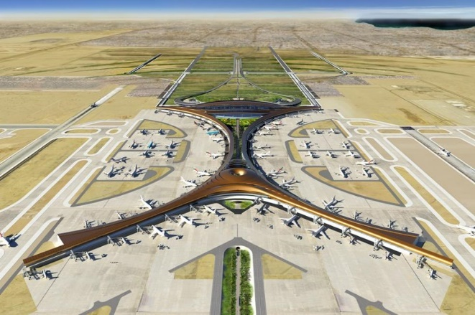
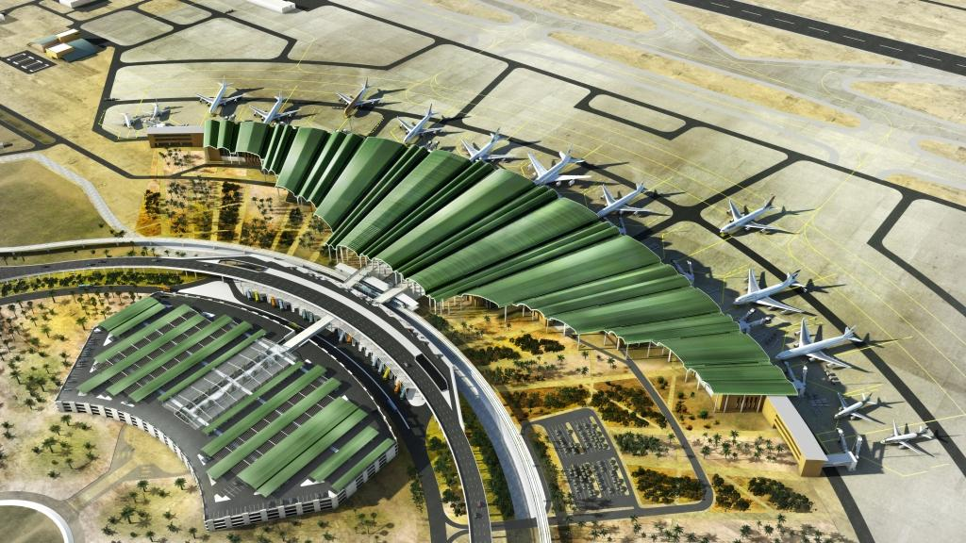
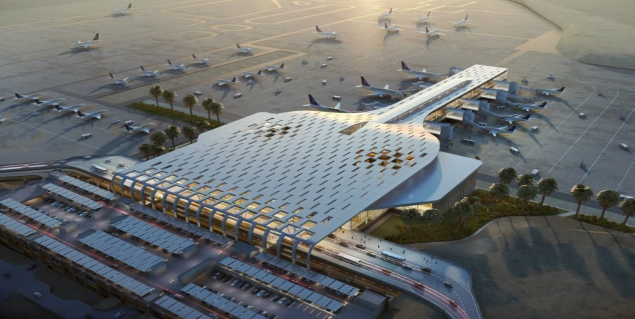
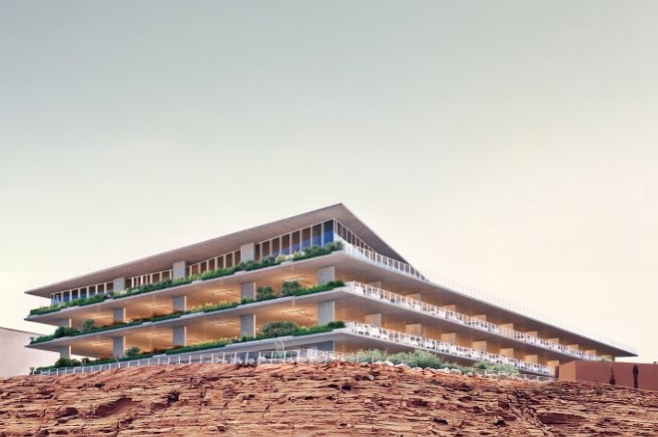
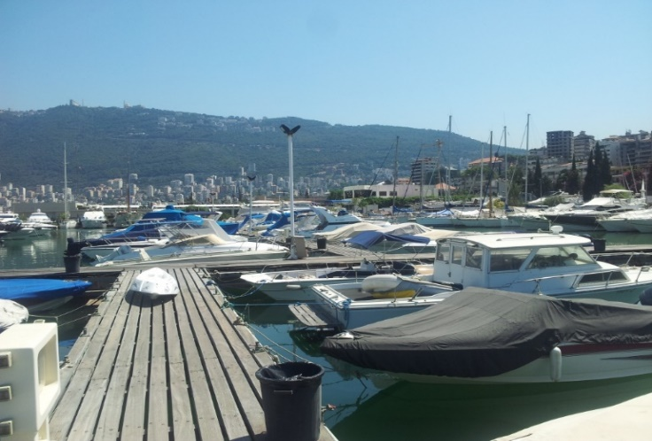
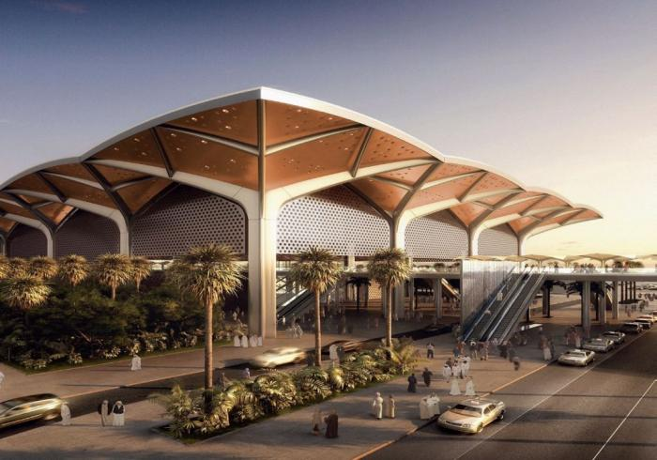
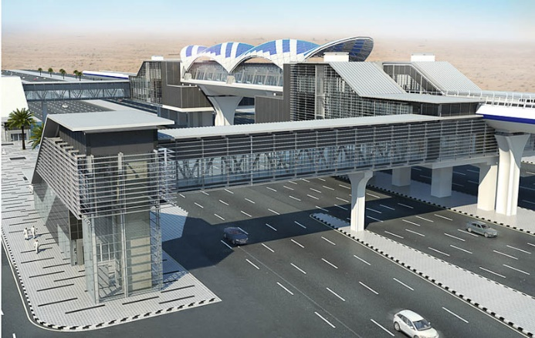
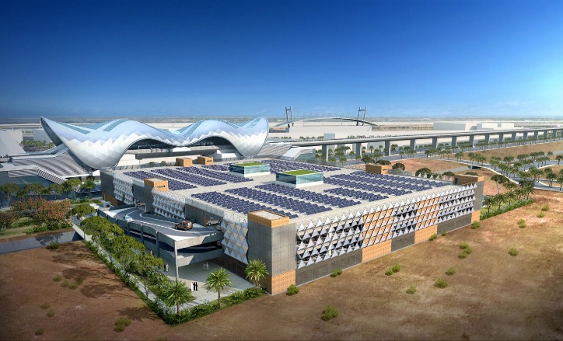
Airports & Stations
Project King AbdulAziz International Airport
Country Saudi Arabia
BUA 300,000 m²
Contractor SBG/Vision
Scope M&E Shop Drawings (PTB Zone D)
& Power Discrimination Study
Project Middle Euphrates International Airport
Country Iraq
BUA 200,000 m²
Consultant ADPi
Scope M&E Load Centers & PTB
Infrastructure Detailed Design
Project Abha Airport
Country Saudi Arabia
BUA 87,000 m²
Architect Edge Arch
Scope M&E Detailed Design
PTB & Parking (REVIT Works)
Project JAX Multistory Car Parks
Country Saudi Arabia
BUA 10,650 m²
Architect Edge Arch
Scope M&E Detailed Design (REVIT Works)
Project ATCL Yacht Club & Marina
Country Lebanon
Area 250 Berths and 77 Yachts Pedestals
Client Automobile et Touring Club du Liban
Scope Quay and Sports Fields Area Lighting
M&E Infrastructure Detailed Design
Project Haramain High Speed Rail KAEC Station
Country Saudi Arabia
BUA 100,000 m²
Contractor El Seif Engineering
Scope M&E Shop Drawings
Project Riyadh Metro Stations, Line 5 & 6
Country Saudi Arabia
Contractor FCC Industrial
Scope M&E Shop Dwgs & As-Built Dwgs
(REVIT Works for Technical Rooms)
Project Riyadh Metro Park & Ride
Country Saudi Arabia
Quantity 3 Stations
Contractor Freyssinet Saudi Arabia
Scope M&E Shop Drawings

Slide 15
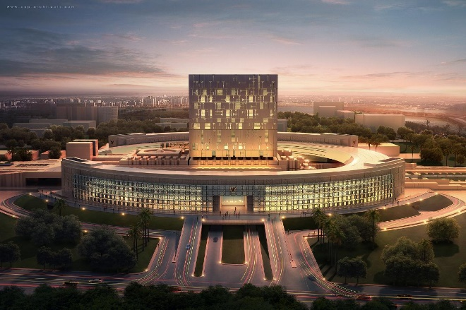
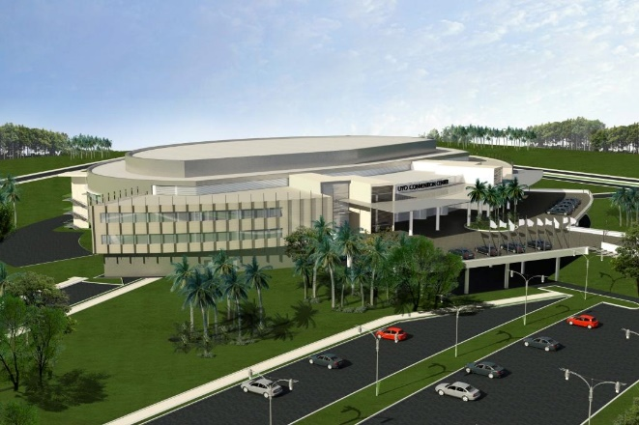
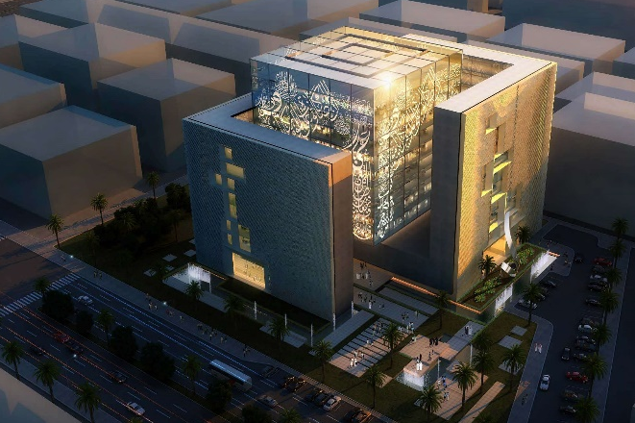
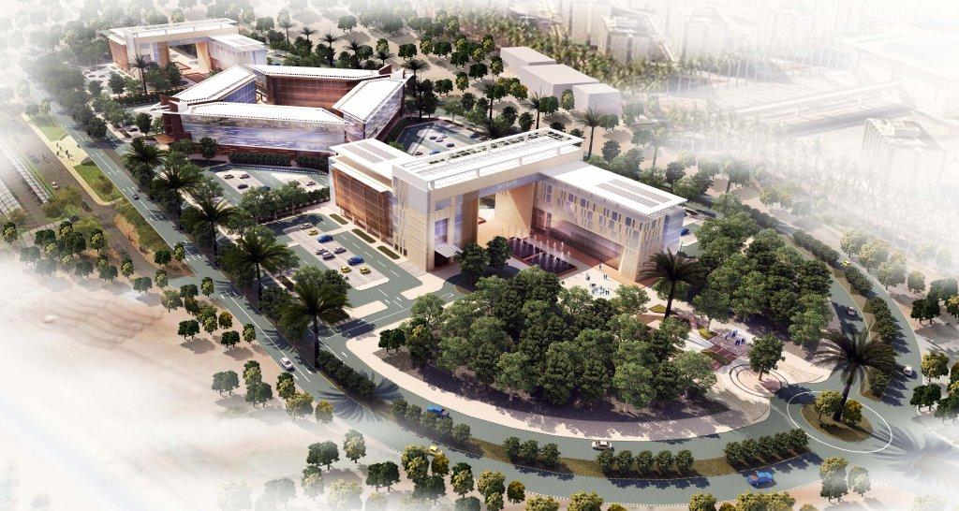
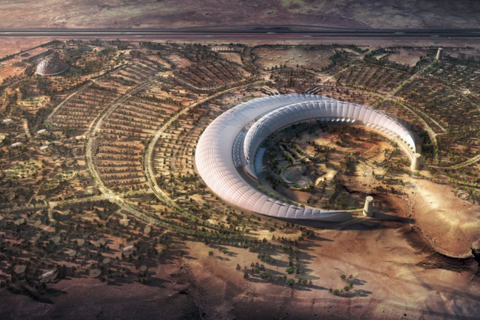
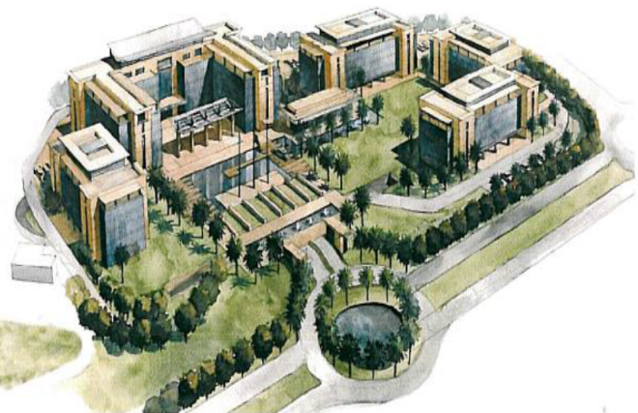
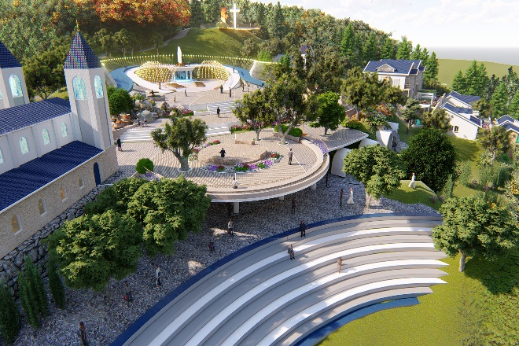
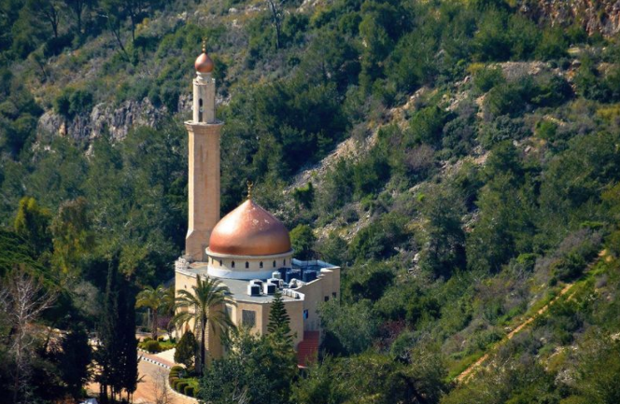
Civic & Religious
Project Baghdad Council of Ministers
Country Iraq
BUA 178,000 m²
Architect CAP
Scope M&E Detailed Design & Follow Up
Project UYO Conventional Center
Country Nigeria
BUA 14,500 m²
Contractor ITB Nigeria
Scope Elec Detailed Design & Follow Up
Project Samawah Cultural Center
Country Iraq
BUA 12,000 m²
Architect CAP
Scope M&E Detailed Design
Project GACA Headquarters
Country Saudi Arabia
BUA 108,000 m²
Contractor BinDayel
Scope M&E Detailed Design REVIT Works for Tech Rooms
Project King Abdullah International Gardens
Country Saudi Arabia
Area 2,400,000 m²
Contractor ZHBG
Scope M&E Infrastructure and Buildings Detailed Designs & Shop Drawings
Arch and M&E REVIT Works for Energy Center
Project Business Park of King Abdullah Economic City
Country Saudi Arabia
BUA 258,000 m²
Contractor Freyssinet Saudi Arabia
Scope M&E Detailed Design
Project Cite Marie
Country Lebanon
BUA 31,500 m²
Client A Toi Marie Association
Scope M&E Design
Project Al Nour Mosque
Country Lebanon
BUA 6,500 m²
Client El Baba
Scope M&E Design

Slide 16
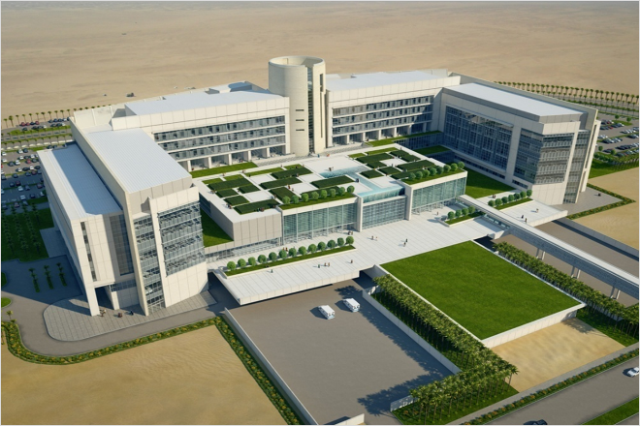
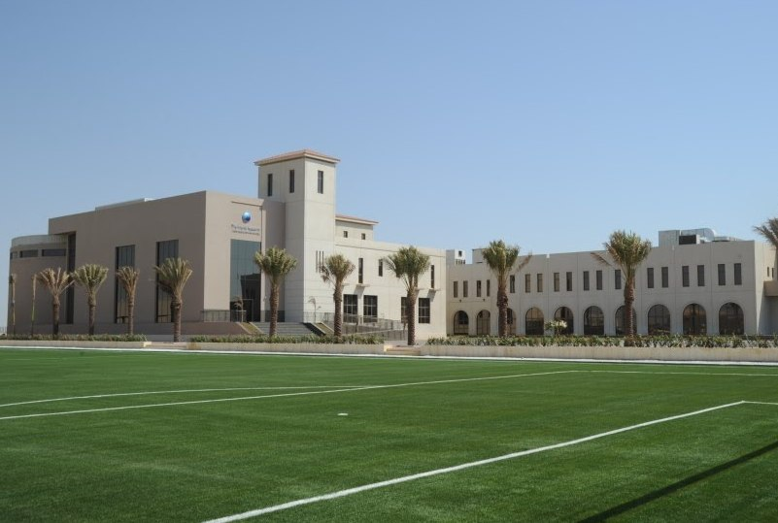
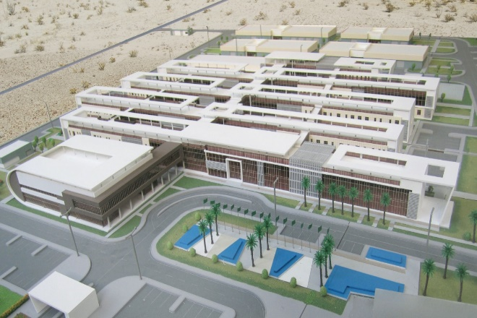
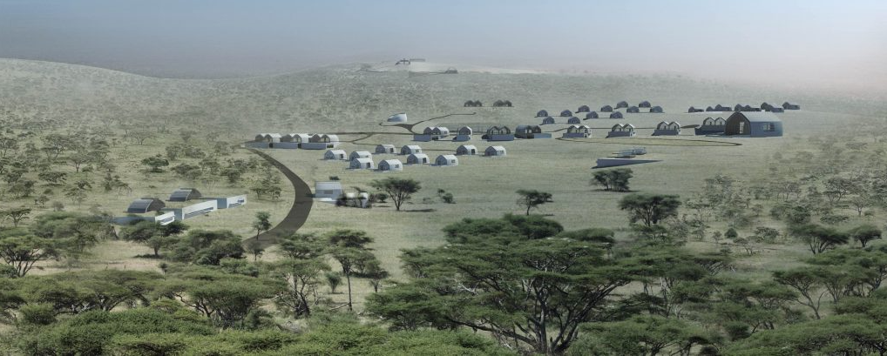
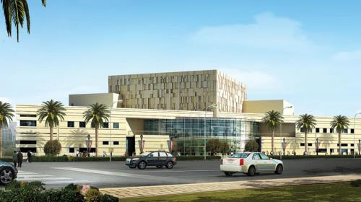
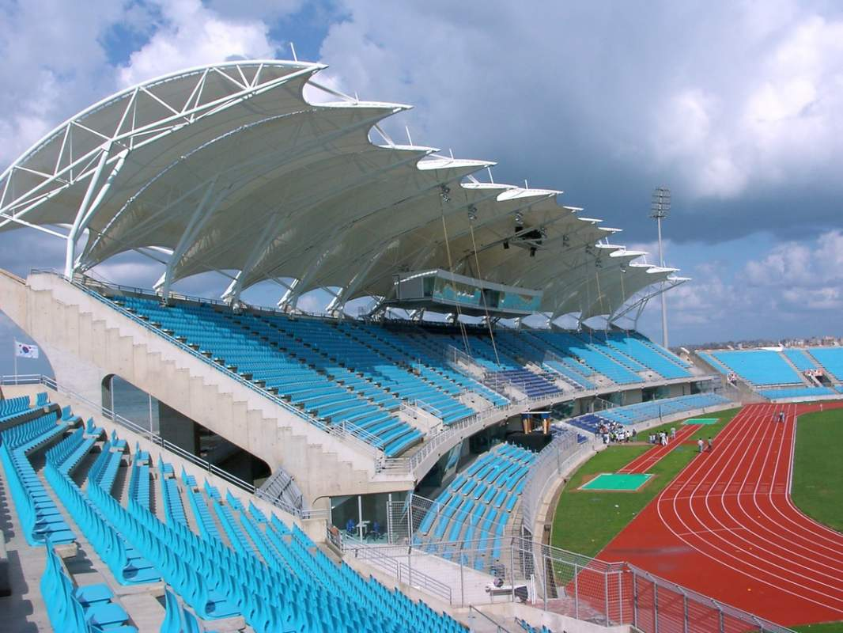
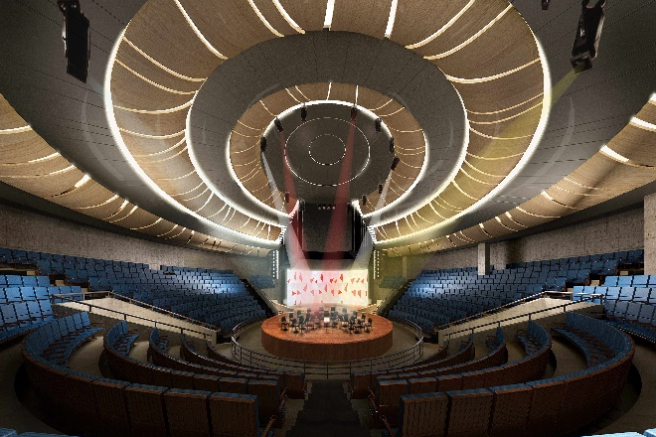
Education & Leisure
Project Princess Noura University
Country Saudi Arabia
BUA 120,000 m²
Contractor Saudi Oger
Scope Elec Shop Drawings
(Hospital and 2 Faculties)
Project GEMS World Academy
Country Saudi Arabia
BUA 22,000 m²
Client KAEC
Scope M&E Detailed Design
Project American International School
Country Saudi Arabia
BUA 32,000 m²
Client Olayan Financing Company
Scope M&E Detailed Design
Project Road & Transport Research Center
Country Saudi Arabia
BUA 38,000 m²
Architect SETS
Scope M&E Detailed Design
Project Happy Childhood Village
Country Tanzania
Land 232,000 m²
Architect ARK
Scope Elec Detailed Design
Project Al Furat TV Broadcasting Station
Country Iraq
BUA 10,000 m²
Architect CAP
Scope Elec Detailed Design
Project Tripoli International Olympic Stadium
Country Lebanon
Capacity 22,400 Seats
Client 4B and BECT
Scope M&E Detailed Design
Project Bayelsa Auditorium
Country Nigeria
BUA 5,000 m²
Architect ARK
Scope M& E Detailed Design

Slide 17
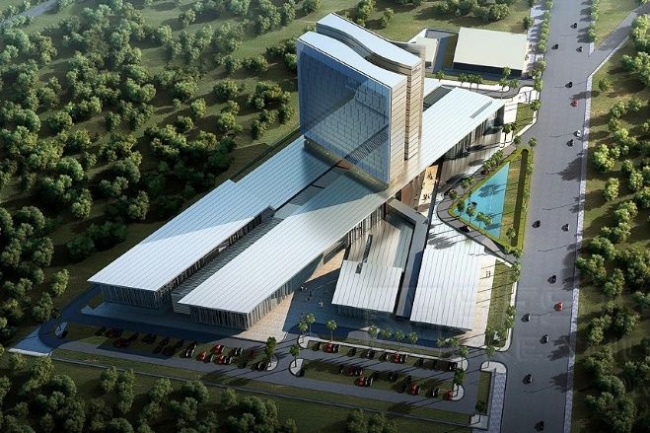
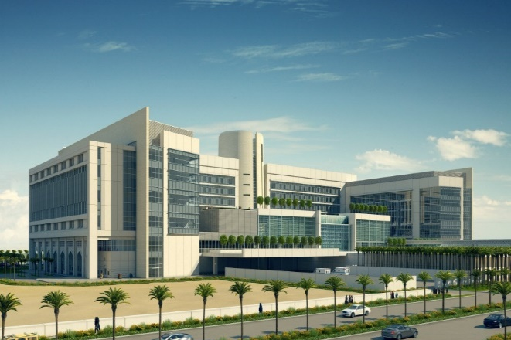
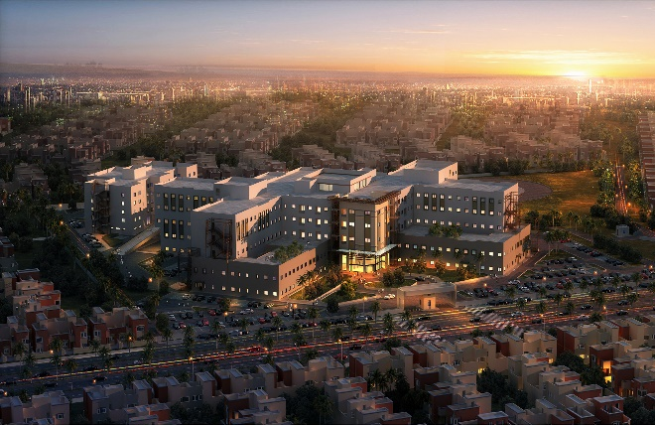
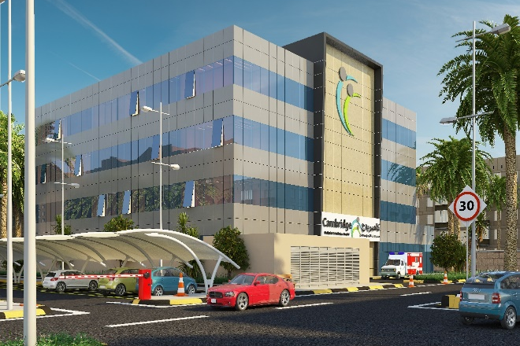
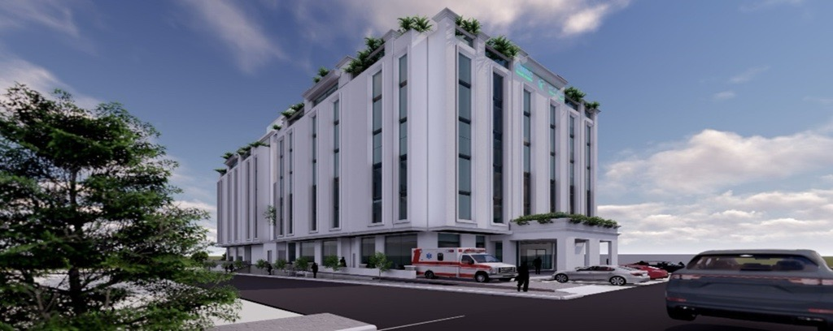
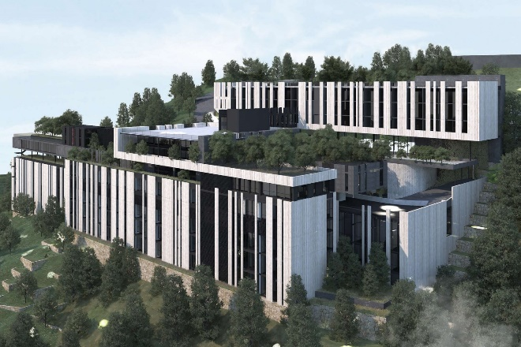
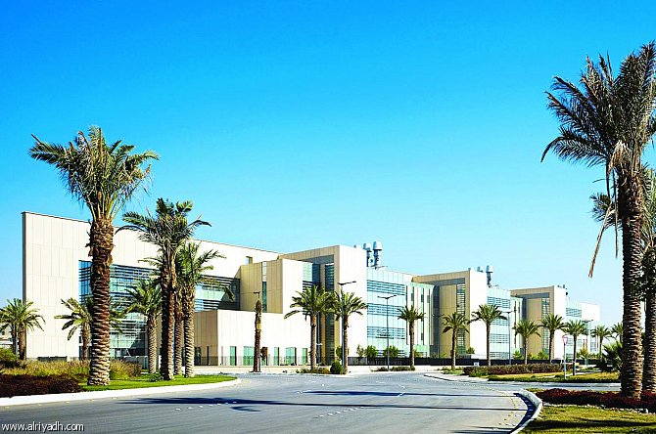
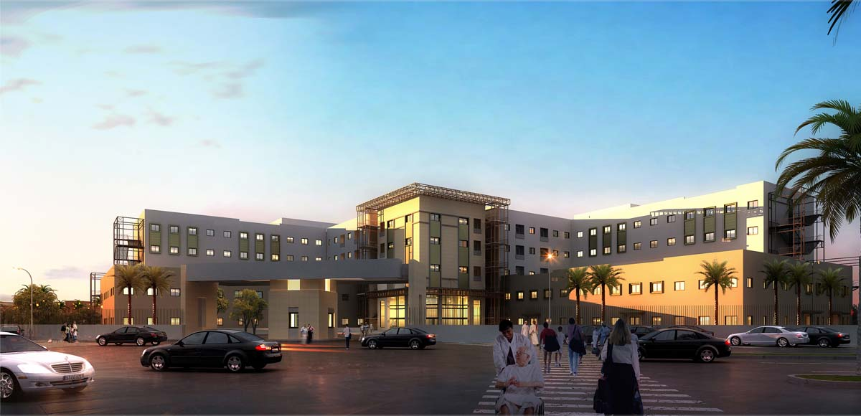
Healthcare
Project Ibn Sina Hospital
Country Iraq
BUA 79,000 m²
Architect CAP
Scope Elec Schematic Design
Project PNU Medical Hospital
Country Saudi Arabia
BUA 120,000 m²
Contractor Al Fayhaa / Oger
Scope Elec Shop Drawings
Project Baghdad Teaching Hospital
Country Iraq
BUA 59,000 m²
Architect CAP
Scope Elec Detailed Design
Project CMRC Hospital I
Country Saudi Arabia
BUA 6,525 m²
Client Cambridge Medical & Rehab Center
Scope M&E Value Engineering
M&E Redesign & Supervision
Project CMRC Hospital II
Country Saudi Arabia
BUA 11,450 m²
Client Richmond
Scope M&E Detailed Design (REVIT Works)
Project Savior Medical Center
Country Lebanon
BUA 49,300 m²
Architect Plan R
Scope Elec Schematic Design
Project Clinical Skills Development Center
Country Saudi Arabia
BUA 23,000 m²
Contractor SBG/VISION
Scope M&E Shop Drawings
Project Baaqouba Teaching Hospital
Country Iraq
BUA 58,000 m²
Architect CAP
Scope Elec Detailed Design

Slide 18
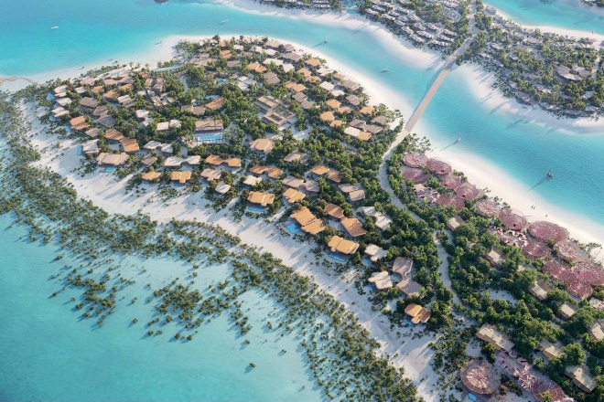
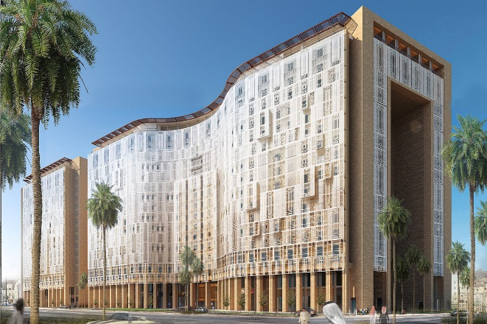
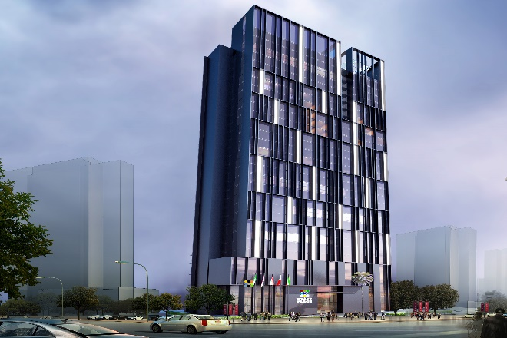
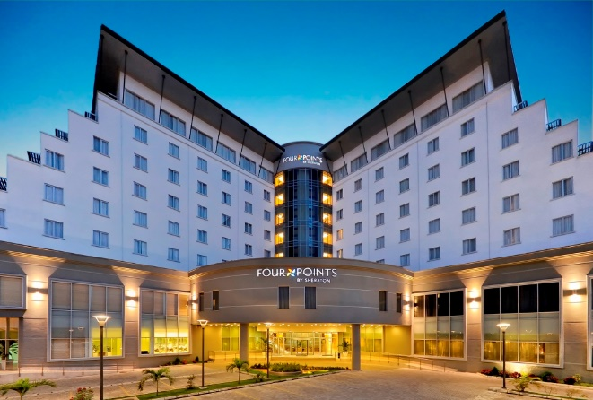
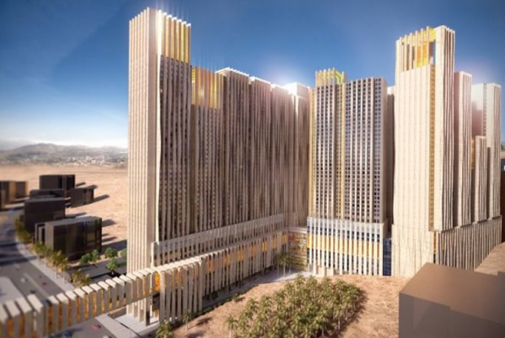
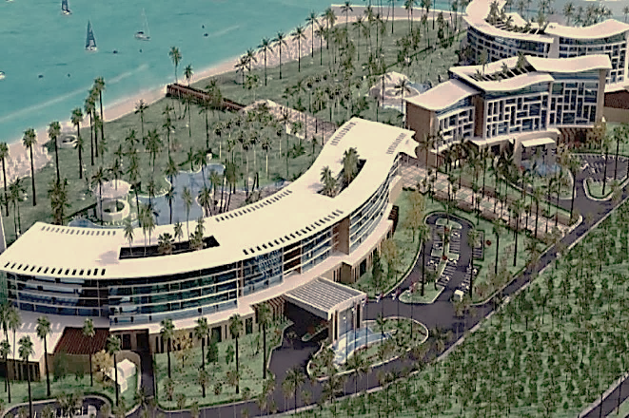
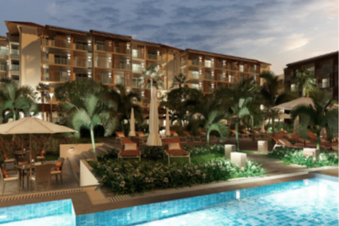
Hospitality
Project Shura Island - Hotel West #1
Country Saudi Arabia
BUA 22,500 m²
Client First Gulf Company
Scope M&E Shop Drawings (REVIT Works)
Project King Abdullah WAQF Tower Hotel
Country Saudi Arabia
BUA 100,000 m²
Client Saudi Oger
Scope Elec Shop Drawings
Project VOCO - IHG Hotel (234 Keys)
Country Saudi Arabia
BUA 44,000 m²
Client Richmond
Scope M&E Detailed Design (REVIT Works)
Project Sheraton Lagos Hotel
Country Nigeria
BUA 22,200 m²
Contractor ITB Nigeria
Scope Elec Detailed Design
Project MAAD Complex Hospitality Towers
Country Saudi Arabia
BUA 225,700 m²
Client MAAD/Al-Jamed
Scope M&E Design & Shop Drawings
REVIT Works (Tech Floors)
Project Hotel Complex Oasis (1001 Keys)
Country Cuba
BUA 128,500 m²
Contractor Bouygues Bâtiment
Scope M&E Schematic Design (REVIT)
Project Roca del Este Hotel I
Country Cuba
BUA 47,000 m²
Contractor Bouygues Bâtiment
Scope M&E Schematic Design
Project Hampton S7 Hotel
Country Saudi Arabia
BUA 18,500 m²
Client MAEC
Scope M&E Detailed Design (REVIT Works)

Slide 19
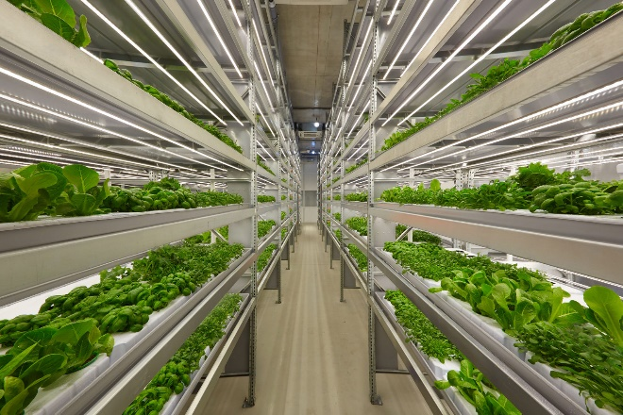





Industrial
Project Vertical Indoor Farms
Country Canada
BUA 15,700 m² + 15,900 m²
Contractor Kolostat
Scope Mech Construction & Fabrication Drawings (REVIT Works)
Project New Jet Propulsion Center
Country Saudi Arabia
BUA 60,000 m²
Contractor Freyssinet Saudi Arabia
Scope M&E Shop Drawings
Project Eni Center of Excellence
Country Congo
BUA 10,200 m²
Contractor Zerock
Scope Elec Shop Drawings
Project Algorithm Pharmaceuticals
Country Lebanon
BUA 15,000 m²
Contractor Betabat
Scope M&E Shop Drawings
Project Industrial Biofuel Agri Hub
Country Congo
BUA 6,800 m²
Contractor Zerock
Scope Electrical Detail Design
Project Cervecería Cubana
Country Latin America
BUA 15,000 m²
Client Bouygues Construction
Scope M&E Design, Shop Drawings & As-Built Drawings
(REVIT Works)

Slide 20






Infrastructure
Project Riyadh Metro – Line 4, 5 & 6
Country Saudi Arabia
Contractor FAST / Samsung
Scope Road Safety Study
Project Jannat Baghdad Development
Country Iraq
Area 28 clusters of 720 Residences,
42 Schools & 20 Mixed-Use Buildings
Architect CAP
Scope M&E Infrastructure Schematic Design
Project Saafat El Basra City
Country Iraq
Area 600,000 m²
Client Al Saqr Al Jareh
Scope M&E Infrastructure Detailed Design
Architecture and M&E Buildings Detailed Design
Project Wasit Water & Sanitation Stations
Country Iraq
Districts Wasit, Daboni, Gassan & Shahimiyah
Consultant CAP
Scope Drainage & Rainwater Infrastructure
Project Diriyah Square – Mega Car Park
Country Saudi Arabia
Area 330,000 m²
Contractor First Gulf Company
Scope MEP Shop Drawings (REVIT Works)
Project Venan Housing Project
Country Saudi Arabia
BUA 450,000 m²
Architect Edge Arch
Scope M&E Infrastructure & Buildings Detailed Design

Slide 21





Mixed Use
Project EKO Tower II
(Residential & Medical Centre)
Country Nigeria
BUA 35,500 m²
Client ITB Nigeria
Scope Elec Detailed Design & Follow up
Project Karbala Oasis Development
(Mall & Hotel)
Country Iraq
BUA 200,000 m²
Architect CAP
Scope M&E Detailed Design
Project Azuri Peninsula
(Residential & Offices)
Country Nigeria
BUA 123,000 m²
Client ITB Nigeria
Scope Electrical Value Engineering & Shop Drawings
Project Palm Towers
(Residential & Offices)
Country Côte d’Ivoire
BUA 11,400 m²
Architect AOT
Scope M&E Detailed Design / M&E Shop Drawings
Project Lawyers & Notaries Tower
(Hotel & Offices)
Country Iraq
BUA 200,000 m²
Client NGC
Scope M&E Detailed Design

Slide 22








Offices
Project Crystal Tower
Country Nigeria
BUA 18,000 m²
Client RMCK Construction
Scope M&E Detailed Design
Project Garden Heights
Country Nigeria
BUA 20,000 m²
Architect Archico Consultants
Scope M&E Detailed Design
Project EKO Tower I
(TOTAL Headquarters)
Country Nigeria
BUA 44,000 m²
Client ITB Nigeria
Scope Elec Detailed Design & Follow up
Project Jeddah Corniche Park Tower
Country Saudi Arabia
BUA 170,000 m2
Contractor Freyssinet Saudi Arabia
Scope Design & Shop Drawings
Project Kingsway Tower
(Microsoft & Facebook Offices)
Country Nigeria
BUA 14,830 m²
Contractor ITB Nigeria
Scope Elec Shop Drawings
Project The Carnelian
Country Nigeria
BUA 33,000 m²
Architect Archico Consultants
Scope M&E Detailed Design
Project Otunba Offices
Country Nigeria
BUA 8,000 m²
Architect Domaine Public Architects
Scope M&E Detailed Design
Project World Bank
Country Nigeria
BUA 4,200 m²
Client ITB Nigeria
Scope Elec Shop Drawings

Slide 23








Power Plants & Data Centers
Project Riyadh Power Plant PP10
Country Saudi Arabia
Size 2,500 MW Power Generation
Contractor Arabian Bemco Contracting
Scope M&E Detailed Design (Industrial Bldgs) Outdoor & Road Lighting
Project Al-Qassim PP Extension #2
Country Saudi Arabia
Size 560 MW Power Generation
Contractor Arabian Bemco Contracting
Scope M&E Design (Industrial Bldgs) Outdoor & Road Lighting
Project Al-Qassim PP Extension #3
Country Saudi Arabia
Size 560 MW Power Generation
Contractor Arabian Bemco Contracting
Scope M&E Design (Industrial Bldgs) Outdoor & Road Lighting
Project King Khaled International Airport
AGL Substations
Country Saudi Arabia
Size 4 MW Power Generation
Contractor Almabani
Scope Architecture and M&E Shop Drawings
Project KAIA Data Centers 1&2
Country Saudi Arabia
Size 11 MW
Contractor SBG/Vision
Scope M&E Shop Drawings
Project Total Headquarters Data Center
Country Nigeria
Size 500 KW
Contractor ITB Nigeria
Scope Elec Detailed Design
Project Africa Data Centers
Country Nigeria
Size 750 KW
Contractor ITB Nigeria
Scope Electrical Shop Drawings
Project eStruxture Data Center
Country Canada
Size 7x230 Ton Cooling Load
Contractor Kolostat
Scope Mechanical Shop Drawings

Slide 24




Residential
Project Meydan I Staff Accommodation
Country UAE
BUA 62,500 m²
Client EMW
Scope M&E Shop Drawings
Project Sky Tower
Country Nigeria
BUA 32,700 m²
Client NGC
Scope M&E Detailed Design
Project Kuramo Beach Residence
Country Nigeria
BUA 71,500 m²
Client ITB Nigeria
Scope Elec Shop Drawings
(REVIT for Elec Rooms)
Project Twin Tower
Country Nigeria
BUA 41,500 m²
Client RMCK
Scope M&E Detailed Design

Slide 25






Retail
Project Zouhour Baghdad Mall
Country Iraq
BUA 150,000 m²
Architect CAP
Scope M&E Detailed Design
Project Kirkuk Mall
Country Iraq
BUA 62,500 m²
Architect CAP
Scope M&E Detailed Design
Project Baghdad Mall
Country Iraq
BUA 750,000 m²
Client NGC
Scope Elec Design Review
Project Marchés Urbains et Régionaux
Country Benin
BUA 9 Markets Districts
Contractor ITB Nigeria
Scope M&E Shop Drawings
Project Kirkuk Landmark Mall
Country Iraq
BUA 55,500 m²
Architect CAP
Scope M&E Detailed Design
Project Erbil City Center
Country Iraq
BUA 637,750 m²
Client NGC
Scope Elec Detailed Design

Slide 26






Value Engineering & Peer Review
Project Jezan Airport
Country Saudi Arabia
BUA 60,000 m²
Architect Edge Arch
Scope M&E Value Engineering
Project Al Khalidia Palace
Country UAE
Area 28,000 m2
Client Architecture Corner
Scope M&E Value Engineering
Project MBL Residence
Country UAE
BUA 70,600 m²
Owner MAG
Scope M&E Value Engineering
Project MAG 5 Boulevard
Country UAE
BUA 140,000 m2
Owner MAG
Scope M&E Value Engineering
Project Entissar Tower
(Residential & Luxury Hotel)
Country UAE
BUA 270,500 m² (570 m height)
Consultant WSP / ae7
Scope M&E Value Engineering
Project Viceroy Tower
Country UAE
BUA 140,000 m²
Consultant Atkins
Scope M&E Value Engineering

Slide 27




Water Treatment Plants
Project GOVERNORATE OF WASIT SEWERAGE PROJECT
Country Iraq
Brief 4 Sewage Treatment Plants using SBR technology
for 4 districts in the Governorate of Wasit
Gassan
    Area: 1.62 km² (162 hectare)
    Population: 28,100 persons
    Pump Stations: 2x3200 LPS each
    Sewage Treatment Plant: 278 LPS
Wassit
    Area: 4.15 km2 (415 hectare)
    Population: 72,000 persons
    Pump Stations: 3x3200 LPS each, 1x6400LPS
    Sewage Treatment Plant: 648 LPS
Shahimiyah
    Area: 1.33 km² (130 hectare)
    Population: 23,100 persons
    Pump Stations: 2x3200 LPS each
    Sewage Treatment Plant: 278 LPS
Daboni
    Area: 2.72 km² (293 hectare)
    Population: 47,183 persons
    Pump Stations: 3x(1600 LPS, 3200 LPS, 6400 LPS)
    Sewage Treatment Plant: 509 LPS
Scope M&E Detailed Design
    Network infrastructure
    Pumping Stations
    Sewage Treatment Plants
GHASSAN DISTRICT
SHAHIMIYAH DISTRICT
Project GOVERNORATE OF QAYARA PROJECT
Country Iraq
Brief River Water Treatment Plant
Area: 0.13 km² (13 hectare)
Flow: 5500 LPS
Scope M&E Detailed Design
    Network infrastructure
    Pumping Stations
WASSIT DISTRICT
DABONI DISTRICT

Slide 28

LEBANON Beirut Al Baba Building, Zahia Selman, Beirut, Lebanon +961 1 833 710 | +961 3 237 001 | GULF Dubai Dubai Silicon Oasis, DDP, Building A2, Dubai, United Arab Emirates +971 54 421 1769
Jal el Dib Al Moudir Center, Jal el Dib, El Metn, Lebanon +961 4 710 253 | +961 3 232 428 | EGYPT Cairo 27 Obour Buildings, Salah Salem St, Heliopolis, Cairo, Egypt +20 222 619 162 | +20 100 051 7495
www.consultemdc.com

